Slide 1
Ethics in Data Science

Slide 2
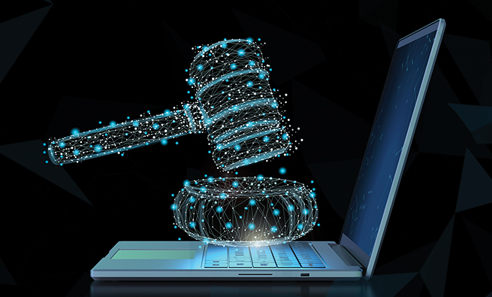
Ethics in Data Science
Ethics address the issues of what is 'right', what is 'just', and what is 'fair’.
It is very important aspect of scientific research, as science itself is incapable of possessing moral or ethical qualities.
Data science is no exception. While data science techniques have potential to bring more efficiency, they also open up the possibility for new forms of discrimination by gender, age, race, etc.
Ethics has to verify the outcomes to be fair among protected groups, including race, color, religion, sex, national origin, age, marital status, receipt of public assistance, etc.

Slide 3
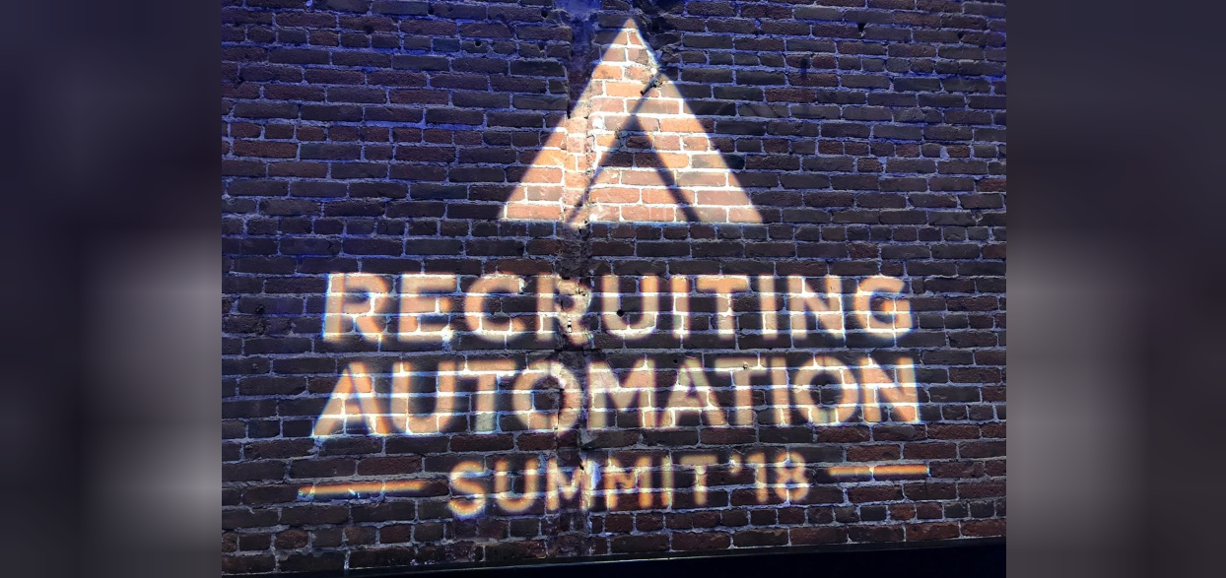
NLP
Amazon’s recruitment tool was scrapped after it was found to be biased against hiring women.
The recruiting tool was built to review job applicants’ resumes to search for top candidates. The tool was trained using data submitted to the company over a decade and given the gender disparity in the tech-industry, the data mostly came from male applicants.
The tool taught itself that male candidates were preferable. It penalized resumes that included the word “women’s” as in “women’s chess club captain.” It also downgraded graduates of two all-women’s colleges. It favored candidates who described themselves using verbs more commonly found on male engineers’ resumes, such as “executed” and “captured.”

Slide 4
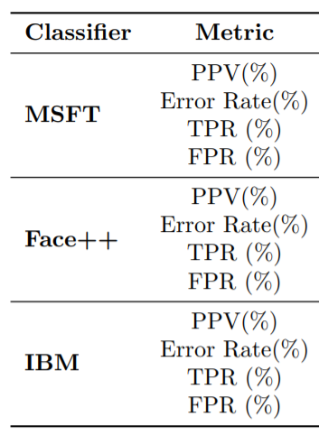
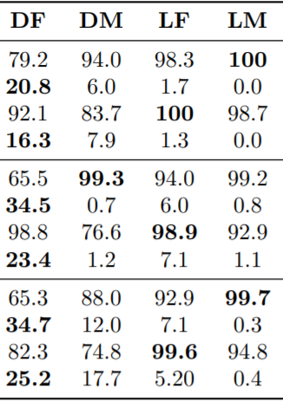
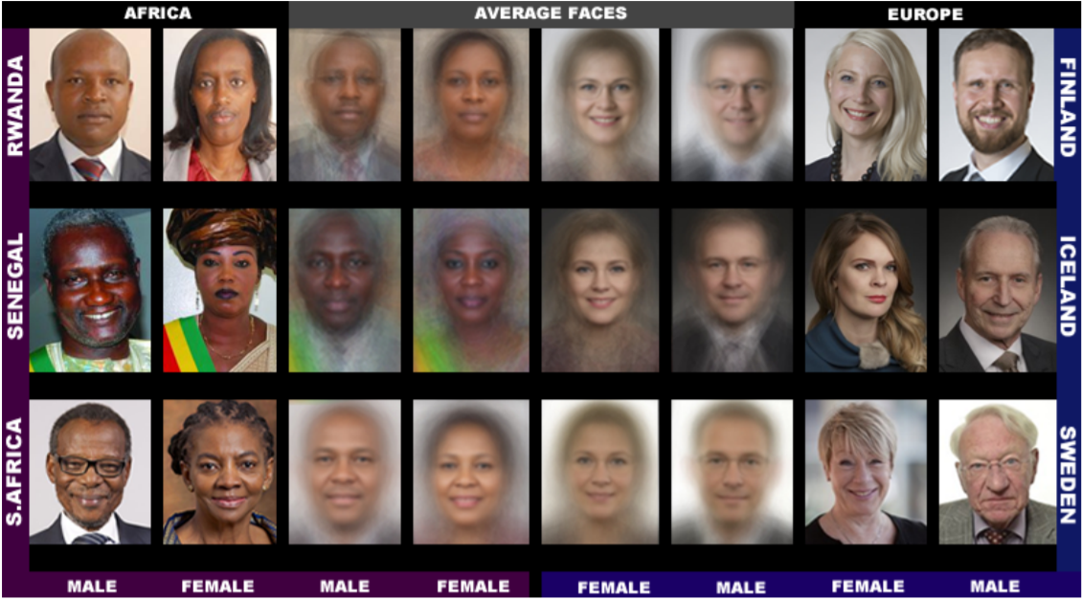
Image Classification
Bias in facial analysis algorithm:
Recent research evaluated 3 commercial gender classification systems and showed that darker-skinned females are the most misclassified group (with error rates of up to 34.7%). The maximum error rate for lighter-skinned males is 0.8%.^{[2]}”
DF/LF : female darker/lighter skinned
DM/LM: male darker/lighter skinned

Slide 5
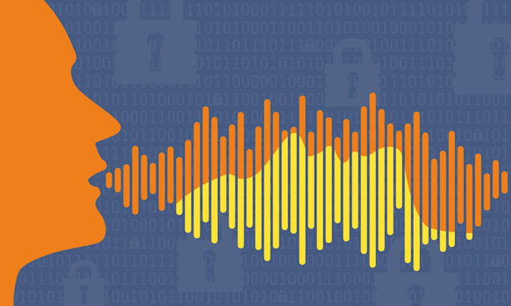
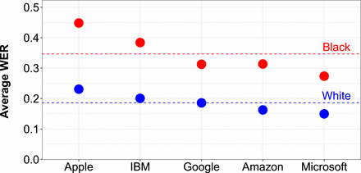
Speech recognition
Racial bias in speech recognition systems:
Significant racial disparities are identified in speech recognition systems from five of the world's biggest tech companies. Based on a Stanford University study, systems from Amazon, Apple, Google, IBM and Microsoft make far more errors with users who are black than those who are white. The average word error rate (WER) across Automated Speech Recognition (ASR) services is 0.35 for audio snippets of black speakers, as opposed to 0.19 for snippets of white speakers.

